Slide 1

OS
natural disaster prediction - technologica

Slide 2

Contents
About Us
Our Idea
Business Plan
Technologies

Slide 3

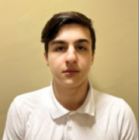


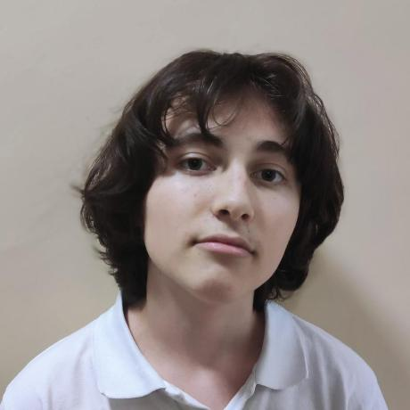
About Us
Ivan Stoychev
Maria Koleva
Frontend developer
Designer
Ivaylo Bachvarov
Stoyan Ivanov
Backend developer
Backend developer

Slide 4
Contents
About Us
Our Idea
Business Plan
Technologies

Slide 5
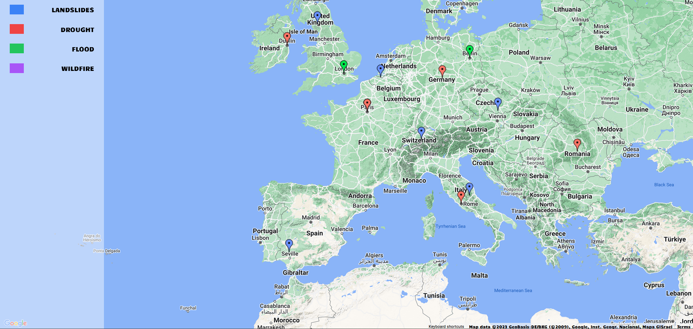
Our Idea
Our idea is to predict natural
disaster possibility based on weather data API such as rainfall, rivers, snowfall, wind, temperature, soil and others using AI.

Slide 6
Contents
About Us
Our Idea
Business Plan
Technologies

Slide 7
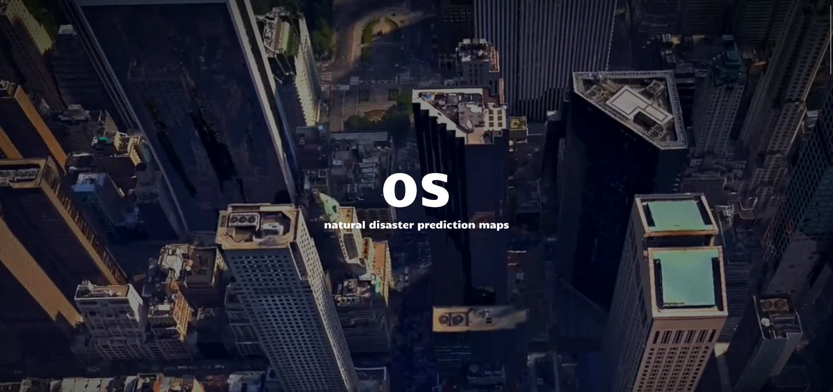
Business Plan
We have a lot of competition, but what makes our product stand out is the AI.

Slide 8
Contents
About Us
Our Idea
Business Plan
Technologies

Slide 9












Technologies

Slide 10
Contents
About Us
Our Idea
Business Plan
Technologies

Slide 11

Now let’s check out a quick demo

